Slide 1
Omnimagnet Mind Map
Mohamed Ghori:
www.linkedin.com/in/mohamedghori , https://github.com/mghorireserach
Aaron Becker:
http://www.ece.uh.edu/faculty/becker
Inspired by Dr. Jake Abbott:
http://www.telerobotics.utah.edu/index.php/Research/Omnimagnets

Slide 2
Mind Map
MAIN
Master Function to run entire Omnimagnet Simulation.
SHAPE
Trajectory Shape Function that rolls the ball through a specific trajectory. Using CNTRL it returns a VISUAL & DATA
CNTRL
Trajectory Following Function that uses MATH to output DATA & Visual
MATH
Math Tools (ie. rotx.m : rotation about the x-axis )
VISUAL
Visualization of the tool’s simulated trajectory
DATA
Solenoid Current Values
MAIN
SHAPE
CNTRL
MATH
Data
VISUAL

Slide 3
MAIN
MAP
SHAPE
MAIN( type, x0, y0, phi, psi, ShapeSize, T, dt, speed, ballsize )
The MAIN function is the highest level function where the rollBallInSquare function and the playback function is called, as well as functions that clear all the figures & clear all the data. The main function has 10 parameters. However, it can be called with 1,6,9, or 10 arguments.

Slide 4
SHAPE
MAP
CNTRL
rollBallInSquare ( x0, y0, phi, psi, ShapeSize, T, dt, speed, ballsize )
rollBallInCirlce ( x0, y0, phi, psi, ShapeSize, T, dt, speed, ballsize)
Playback (currx, curry, currz,wHb)

Slide 5
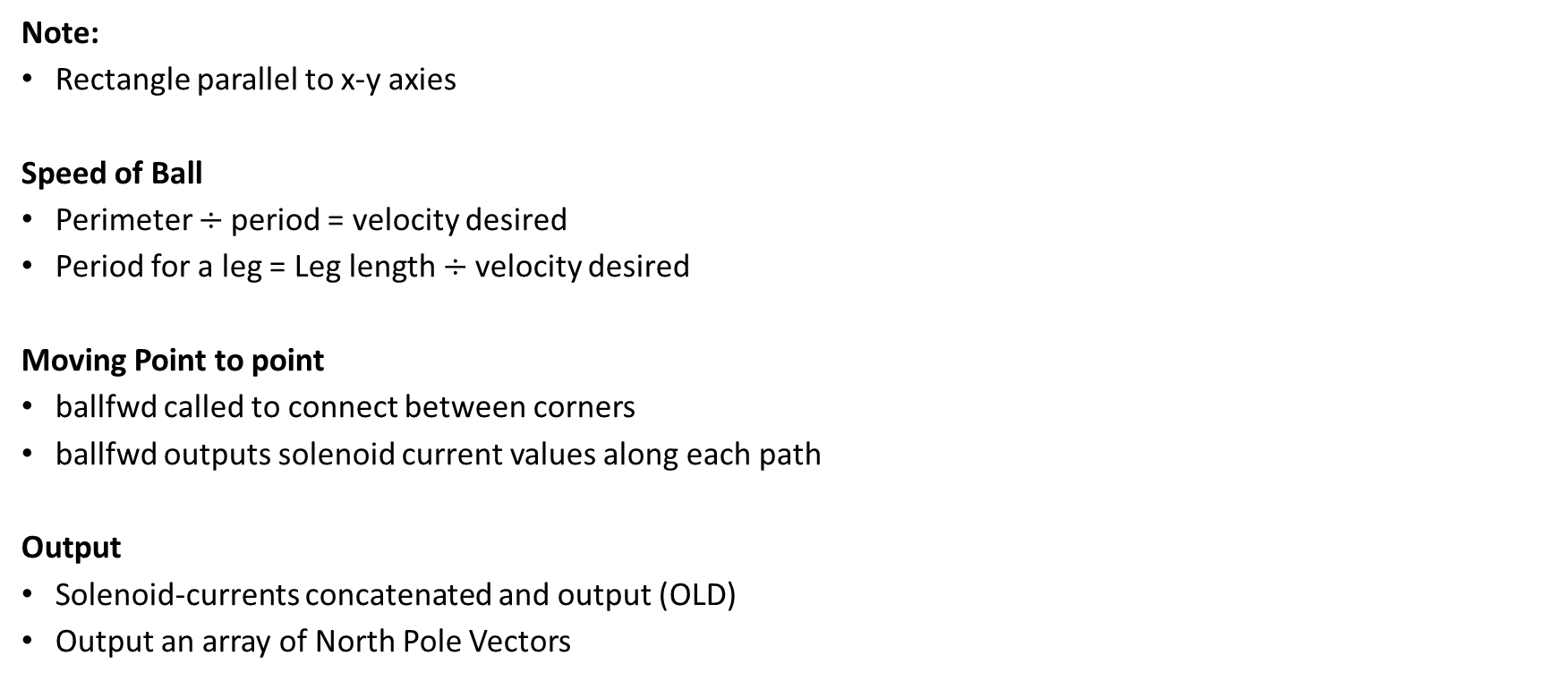
rollBallInSquare
SHAPE
Note:
Rectangle parallel to x-y axies
Speed of Ball
Perimeter $÷$period = velocity desired
Period for a leg = Leg length $÷$velocity desired
Moving Point to point
ballfwd called to connect between corners
ballfwd outputs solenoid current values along each path
Output
Solenoid-currents concatenated and output (OLD)
Output an array of North Pole Vectors
Velocity
Magnet
N

Slide 6
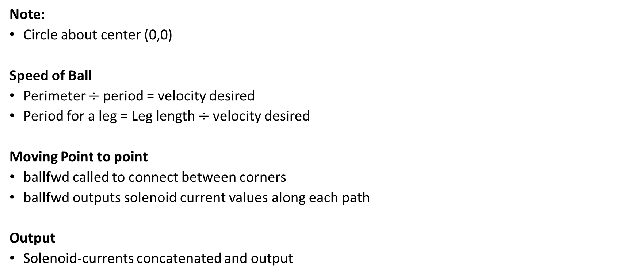
rollBallInCircle
SHAPE
Note:
Circle about center (0,0)
Speed of Ball
Perimeter $÷$period = velocity desired
Period for a leg = Leg length $÷$velocity desired
Moving Point to point
ballfwd called to connect between corners
ballfwd outputs solenoid current values along each path
Output
Solenoid-currents concatenated and output
Velocity
Magnet
N

Slide 7
playback
SHAPE
Moving Point from Orientation to Orientation
The North-Pole vectors that were recorded are used with fwdcurrent to rotate between such that the north pole coincides with the final north pole vector.
Output
A visual of the ball tool following this path
Velocity
Magnet
N

Slide 8
CNTRL
MAP
MATH
Ballfwd ( p0, pf, wHb, T, dt, speed, ballsize )
Fwdcurrent ( I0, If, wHb, T, dt, speed, ballsize )
fwdMagneticField ( currx, curry, currz, x, y )
inverseMagneticField ( x, y, phi, psi )

Slide 9
ballfwd
CNTRL
Note:
Rolling about Magnetic Field y-Axis
Method
Find Goal:
Rotate about world z-axis
T(ballfwd Period)/4
Return current for orientation snapshots at “0 : dt :T/4”
Roll to Goal:
Rotate about Magnetic Field y-Axis
3T/4
Return current for orientation snapshots at “T/4 : dt : T”
Output
currx, curry , currz vectors for solenoid-current input

Slide 10
fwdcurrent
CNTRL
Note:
Rotates magnetic Field around single axis
Rotating Tool
Method:
Two consecutive orientations are found using two consecutive current vectors
The orientations are decomposed in terms of rotation in the xy-plane(phi) & the xz-plane(psi)
The difference in psi and phi are then converted to a rotation matrix
This rotation matrix is decomposed into an axis and angle rotation
The magnetic field is then rotated about this axis
The linear velocity consists of the rotation vector in the xy-plane
Output:
Final Position and Orientation (pf, wRb)

Slide 11
fwdMagneticField
CNTRL
Note:
The equations are not linear and there fore when back tracking one does not find the same vectors
Input:
Electric Current for each solenoid (currx,curry,currz)
Current Position of Ball (x,y)
EQN:
Current put in as a vector into equation from Jake Abbott
Output:
Magnetic Field Vector Tangent to Magnetic Field at the Tool

Slide 12
inverseMagneticField
CNTRL
Input:
Orientation of the magnetic field at the Tool (phi,psi)
Current Position of Ball (x,y)
EQN:
Magnetic Field vector constructed using orientation with a magnitude of 100
Magnetic Field vector put into equation from Jake Abbott
Output:
Electric Current for each solenoid [currx; curry; currz]

Slide 13
MATH
MAP
VISUAL
piont2piontroll (vect1,vect2)
rotTime (deltheta,omega0, alph)
Rot_in_phipsi (R)
Vect2skew (vector)
Axis2rot (Axis,Angle)
rot2Axis (R)
rot2quat(R)
quatmult (q1,q2)
Rotx (roll)
Roty (pitch)
Rotz (yaw)

Slide 14
point2piontroll
MATH
Implemented Dr. Becker's Code: "Roll Any Point on the Sphere to any desired Latitude-Longitude Coordinates with one Straight-Line Roll“

Slide 15
rotTime
MATH
Uses kinematic th = th0 + w0*t + 0.5*alph*t^2 to calculate the time required to reach a certain position using a given angular acceleration(from torque)

Slide 16
Rot_in_phipsi
MATH
This function returns the phi (angle of vector with the x-axis in x-z plane) and psi (angle of vector the x-axis in the y-x-plane )

Slide 17
findPhiPsi
MATH
Using “arccos” to find the angle from the world x-axis in the zx-plane (psi)
Using “arccos” to find the angle from the world x-axis in the xy-plane (phi)

Slide 18
anglediff
MATH
Find the angle of the two vectors with respect to the world x-axis in the xy-plane
The difference between these two angles is the angle between vectors

Slide 19


vect2skew
MATH
Converts from a vector its skew symmetric matrix form
Skew-Symmetric Form
Unit-Vector
$$\left[\begin{matrix}0 & −z & y \\ z & 0 & −x \\ −y & x & 0\end{matrix}\right]$$
$$\left[\begin{matrix}x \\ y \\ z\end{matrix}\right]$$

Slide 20
axis2rot
MATH
Converts from an axis angle notation of a rotation to a rotation matrix in 3D Euclidean space

Slide 21
rot2axis
MATH
Converts from a rotation matrix to an axis angle notation for rotation in 3D euclidean space

Slide 22
rot2quat
Converts a rotation matrix into its quaternion form

Slide 23
quatmult
A function that multiplies two quaternions

Slide 24
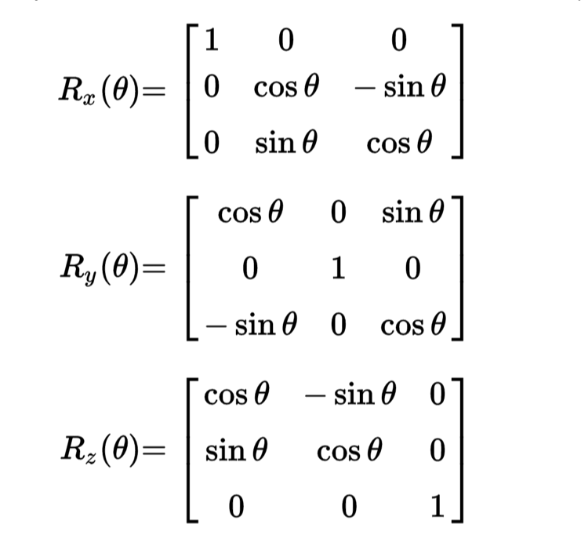
rotx roty rotz
MATH
Basic Euler rotation matrix equations (roll, pitch, yaw)

Slide 25
VISUAL
MAP
DATA
plot_ball (ballsize, pos,R,dt,speed)
Showmagfield (currx,curry,currz,p0)
Magfield (I)

Slide 26
plot_ball
VISUAL
First Call creates a figure of equal axis at a corner view
Draws a transparent sphere
Draws a quiver along the z-axis and y-axis of the magnetic field
Then transforms it using a homogeneous matrix (MATLAB:hgtransform)

Slide 27
showmagfield
Draws a magnetic field line using a series of 200 segments (quivers) from head to tail

Slide 28
magfield
Draws the magnetic field based on the solenoid current
NOTE: Does not use meshgrid
NOTE: The entire field is pointing in one direction (which may be incorrect)

Slide 29
DATA
MAP
Solenoid-current(curra, currb, currc)

